Slide 1
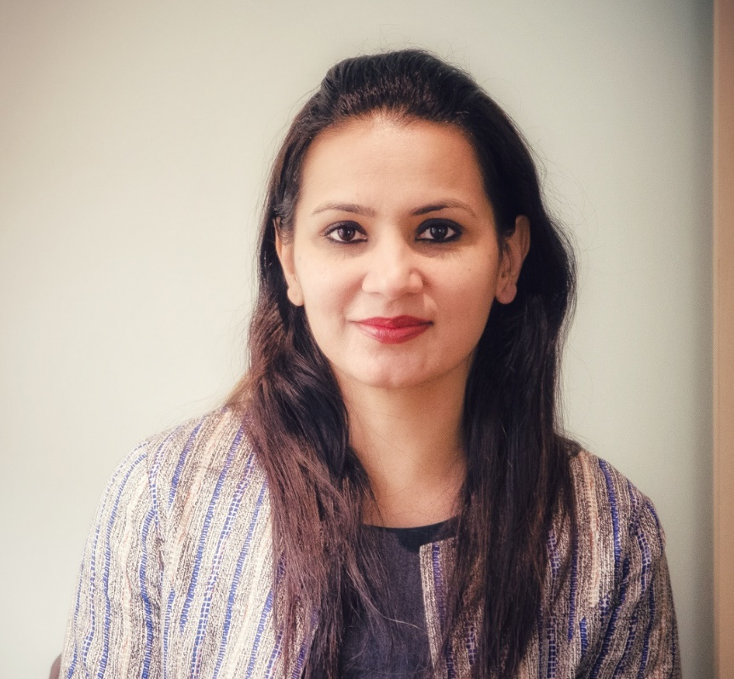
Professional Synopsis : Shilpa
Shilpa Narang
Program manager in RB-CoC SW V&V
Shilpa is carrying 16+ years of rich industry experience and associated with Bosch since 10+ years with focus on Delivery Management, Competency & Project Management for diverse technology projects including Cloud, Mobile Apps, Enterprise applications, IOT & Embedded Platforms.
In 2019, she joined M/NE division as a Program manager in RB-CoC SW V&V to support and strengethen V&V initiatives in RBEI in close calloboration with RBEI-CoE (RBEI/EVS), regions and divisions.
Prior to this, Shilpa was a Group Manager at RBEI/BSD and was responsible for Testing services for enterprise applications (NON-ERP).
On Personal front, she has a happy home with a daughter and friendly husband. She treats Bangalore as her native with her extended family staying close by.

